Slide 1
Sustainability Advisory Committee
Sustainability Strategic Plan

Slide 2
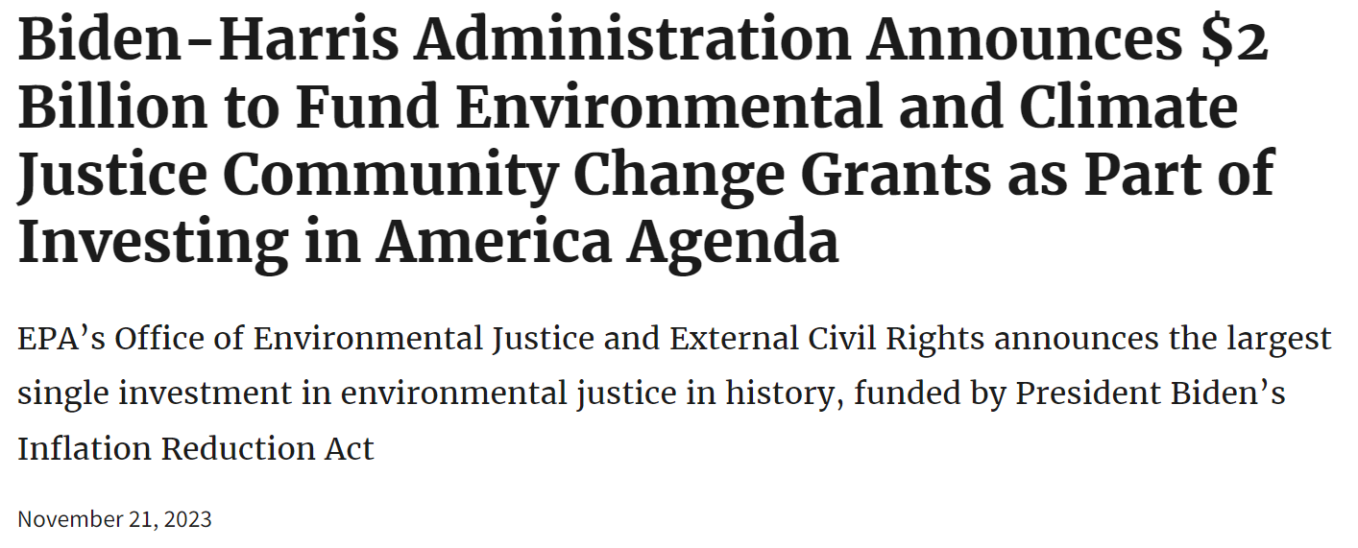

Slide 3
Sustainability Plans
University of Louisiana at Lafayette
University of Washington
American University
LSU - Plan
Plan
Plan
10 Targets
Plan

Slide 4
Sustainability Advisory Committee Meeting
Reviewing the Sustainability Strategic Plan
1st Draft, Version 1 | Review the 1st draft and change as the committee recommends
2nd Draft, Version 1 | Updates edits to the draft and send to the committee for final approval
Approved Draft, Version 1 | Submit to the Board for review and acceptance
Board Accepted Draft, Version 1 | Submit to EPA along with grant app Submit for inclusion on Dillard’s website Work with the Communication office to begin to disseminate via social media Present to Bleu Green Krewe for feedback and updates for next version
1st Draft, Version 2 | Director of Sustainability will update Version 1 regularly with new ideas and needs
2nd Draft, Version 2 | The Committee will meet in 12-24 months to review and approve a new version of the plan that meets the changing needs of the university

Slide 5
Sustainability Strategic Plan
1st Draft, Version 1

Slide 6
Thank you

